Slide 1
C Programming

Slide 2
Arrays

Slide 3
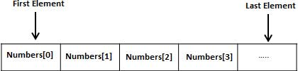
Arrays - Introduction
Definition: Array is a derived data type. Array is a collections of variables of same type.
Fixed size, size defines the number of elements in the array
Stored in contiguous memory locations
Array element is accessed by its index value

Slide 4
Declaring & Initializing Array
Declaration: type Array_Name [array size]
Example: 5 element array of integer type
int arr [5];
int arr[ ] = {1,2,3,4,5};
Initialization:
for(j=0;j<5;,j++)
arr [ j ]=j+1;

Slide 5
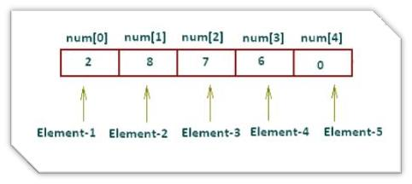
Declaring & Initializing Array
Array Size specified Directly:
int num[5] = {2,8,7,6,0};
Array Size specified In-Directly:
int num[] = {2,8,7,6,0};

Slide 6
Visualizing 1-D Arrays
Representing a single dimension Array
int A[10];
[0] | [1] | [2] | [3] | [4] | [5] | [6] | [7] | [8] | [9]
Base +0 +4 +8 +12 +16 etc.
Address
Notes:
a-spec
Is an optional array specification, enclosed in parentheses. If POINTER or ALLOCATABLE is specified, the array is deferred shape; otherwise, it is explicit shape. In an explicit-shape specification, each bound must be a constant scalar integer expression.

Slide 7
Accessing Arrays & Operations
Individual element can be accessed using Index
Example:
Int arr [10];
Int value = arr[0];
NOTE:
Don't try to access an element that is not in the array such as the eleventh element of a ten element array.
Case of “ out of bounds”
Attempting to access a value past the end of an array will either crash your program or worse retrieve garbage data without telling you that an error occurred.
Examples:
int arr [10];
int i=0;
Int value = arr[i];

Slide 8
Example of 1-D Array
int iarr[3] = {2, 3, 4};
char carr[20] = “ACTS" ;
float farr[3] = {12.5,13.5,14.5} ;
Notes:
a-spec
Is an optional array specification, enclosed in parentheses. If POINTER or ALLOCATABLE is specified, the array is deferred shape; otherwise, it is explicit shape. In an explicit-shape specification, each bound must be a constant scalar integer expression.

Slide 9
program on 1-D Array
#include <stdio.h>
int main()
{
int num[] = {21,18,57,45,50};
int i;
for(i=0;i<5;i++)
{
printf("\n Integer Array Element num[%d] : %d",i+1,num[i]);
}
return 0;
}
Notes:
a-spec
Is an optional array specification, enclosed in parentheses. If POINTER or ALLOCATABLE is specified, the array is deferred shape; otherwise, it is explicit shape. In an explicit-shape specification, each bound must be a constant scalar integer expression.

Slide 10
1-D Array
1-D Array Program
Write a C Program to display one dimensional array elements with addresses
Write a C Program to Calculate Addition and average of All Elements in one dimensional array
Write a C Program to Find Greatest Element in Array in one dimensional array
Write a C Program to Search an element in 1-D Array
Notes:
a-spec
Is an optional array specification, enclosed in parentheses. If POINTER or ALLOCATABLE is specified, the array is deferred shape; otherwise, it is explicit shape. In an explicit-shape specification, each bound must be a constant scalar integer expression.

Slide 11
Multidimensional Arrays

Slide 12
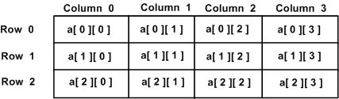
Multidimensional Arrays
Arrays with more than one dimension
2D Arrays : grid of rows and columns
GCC allows arrays of up to 29 dimensions (source:linuxtopia.com)
Using an array of more than three dimensions is very rare
Representing a double dimension Array
integer a[3] [4] ;

Slide 13
Memory Representation – 2D Arrays
0x1014
mat[1][2]
0x1010
mat[1][1]
int mat[2][3];
mat[1][0] = 17;
0x100C
mat[1][0]
0x1008
mat[0][2]
0x1004
mat[0][1]
Valid Initialization
0x1000
mat[0][0]
What happens when you initialize
mat[0][3] = 20;
No bounds checking…causes no error

Slide 14
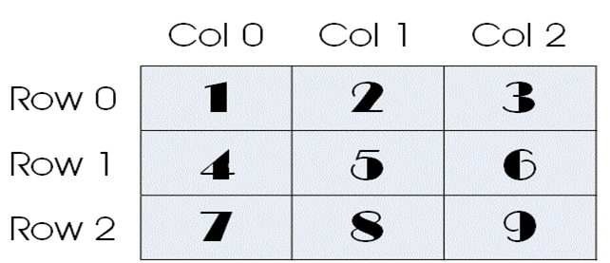
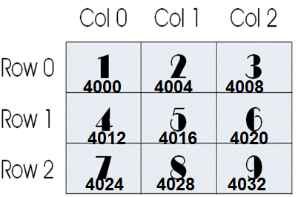
2D Arrays
A[3][3]={1,2,3,4,5,6,7,8,9};
A[3][3]={ {1,2,3},{4,5,6},{7,8,9} }; // array of 1D array
a[0][1] = a[0][0] + Size of Data Type
[0][0] | [0][1] | [0][2] | [1][0] | [1][1] | [1][2] | [2][0] | [2][1] | [2][2]
Base +0 +4 +8 +12 +16 etc.
Address

Slide 15
Initializing 2D Arrays
#include<stdio.h>
int main()
{
int i, j;
int a[3][2] = {
{ 1, 4 },
{ 5, 2 },
{ 6, 5 }
};
for (i = 0; i < 3; i++)
{
for (j = 0; j < 2; j++)
{
printf("%d ", a[i][j]);
}
printf("\n");
}
return 0;
}
1 4
5 2
6 5

Slide 16
Initializing 2D Arrays
#include<stdio.h>
int main()
{
int i, j;
int a[3][2] = { 1, 4, 5, 2, 6, 5 };
for (i = 0; i < 3; i++)
{
for (j = 0; j < 2; j++)
{
printf("%d ", a[i][j]);
}
printf("\n");
}
return 0;
}
1 4
5 2
6 5

Slide 17
Initializing 2D Arrays
#include<stdio.h>
int main()
{
int i, j;
int a[3][2] = {
{ 1 },
{ 5 , 2 },
{ 6 }
};
for (i = 0; i < 3; i++)
{
for (j = 0; j < 2; j++)
{
printf("%d ", a[i][j]);
}
printf("\n");
}
return 0;
}
1 0
5 2
6 0

Slide 18
3D array – array of 2D Arrays
#include<stdio.h>
int main()
{
int i, j,k;
int a[2][3][4] = {
{ {1, 2, 3, 4}, {5, 6, 7, 8}, {9, 10, 11, 12} },
{ {13,14, 15, 16}, {17, 18, 19, 20}, {21, 22, 23, 24} }
};
for (i = 0; i < 2; i++)
{
for (j = 0; j < 3; j++)
{
for (k = 0; k < 4; k++)
{
printf("%d ", a[i][j][k]);
}
printf("\n");
}
printf("\n");
}
return 0;
}

